Slide 1
DEM : Diagnostic Event Manager
Overview

Slide 2
DEM : Diagnostic Event Manager

Slide 3
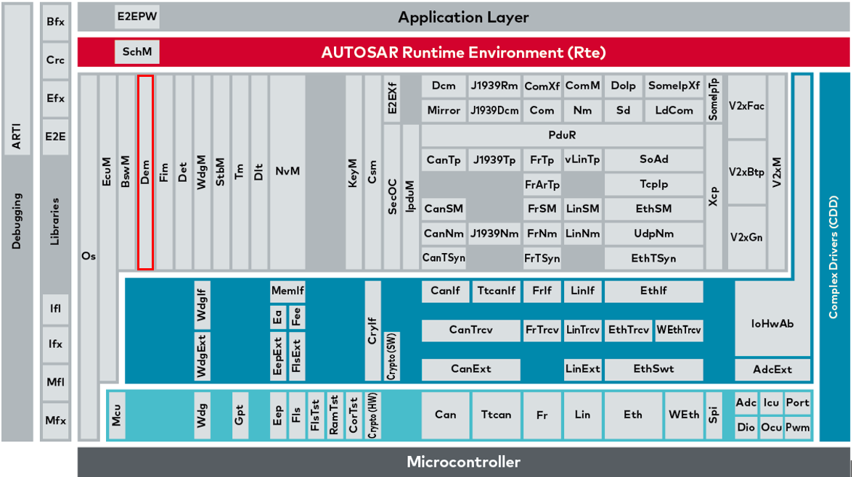
DEM

Slide 4
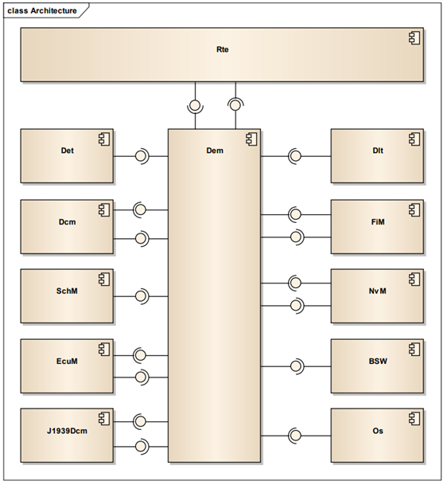
Diagnostic Event Manager
Responsible for processing and storing Diagnostic event and associated environmental data
Provides fault information data to DCM
Provides warning indication suppose an event request is occurred
Stores the status of an event for OBD-2 relevant DTC

Slide 5
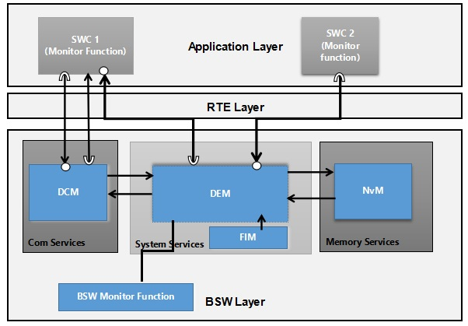
Dependencies
SWCs : Reports the event status. Monitors the event and sets the status of the event
NvM : Store the event status and Environmental data of each event. Snapshot data/Freeze frame , Extended data
DCM : Read diagnostic information. Provides event related data to tester
BSW modules : Reports the event status. Monitors the event and sets the status of the event. Also used to set the MIL status.
FIM : Configure and modify the inhibiting conditions of the functionalities.eg : To stop/ restrict the functionality based on the DTC status.

Slide 6
Diagnostic event
Diagnostic event : Result of a monitor
Monitored by SWCs / BSW components.
Eg: Health of a battery
Each event has its own event priority based upon the level of importance
Event IDs are assigned to an event. SWCs and BSW components reports the event status to DEM using event ID.
Event status :
PASSED
FAILED
There are two different types of events:
BSW-related events (reported via C-API - Dem_SetEventStatus)
SW-C-related events (reported via RTE operation - SetEventStatus)

Slide 7
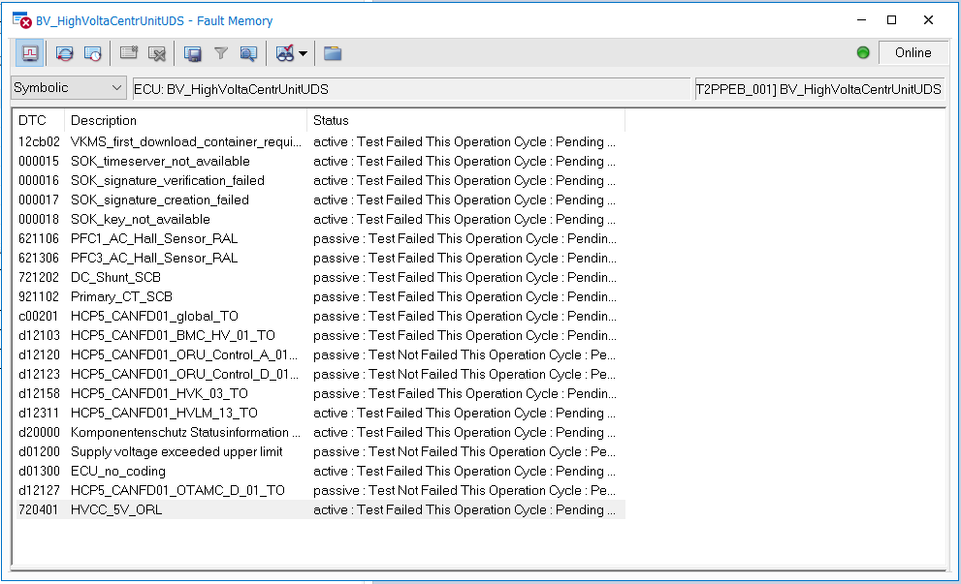
Fault memory

Slide 8
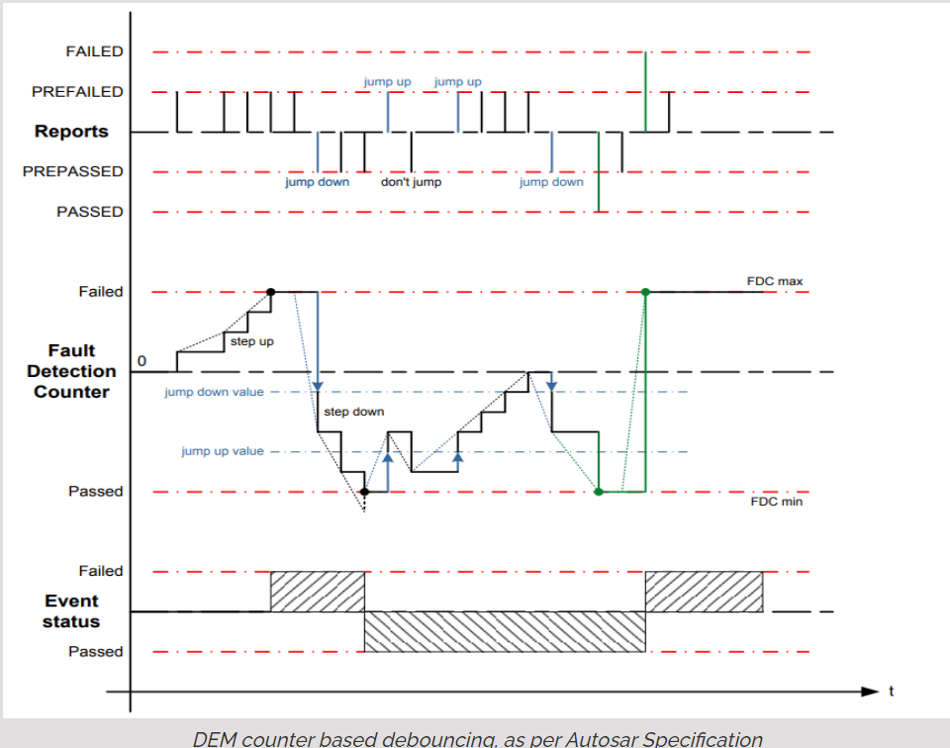
Event debouncing
Qualifying the fault before it is reported as a DTC
Counter Based Debouncing : In counter based debouncing, every time you set an event to PREPASSED or PREFAILED, you are increasing / decreasing a counter by a number of steps. After a certain threshold is reached, the event is debounced as FAILED or PASSED.

Slide 9
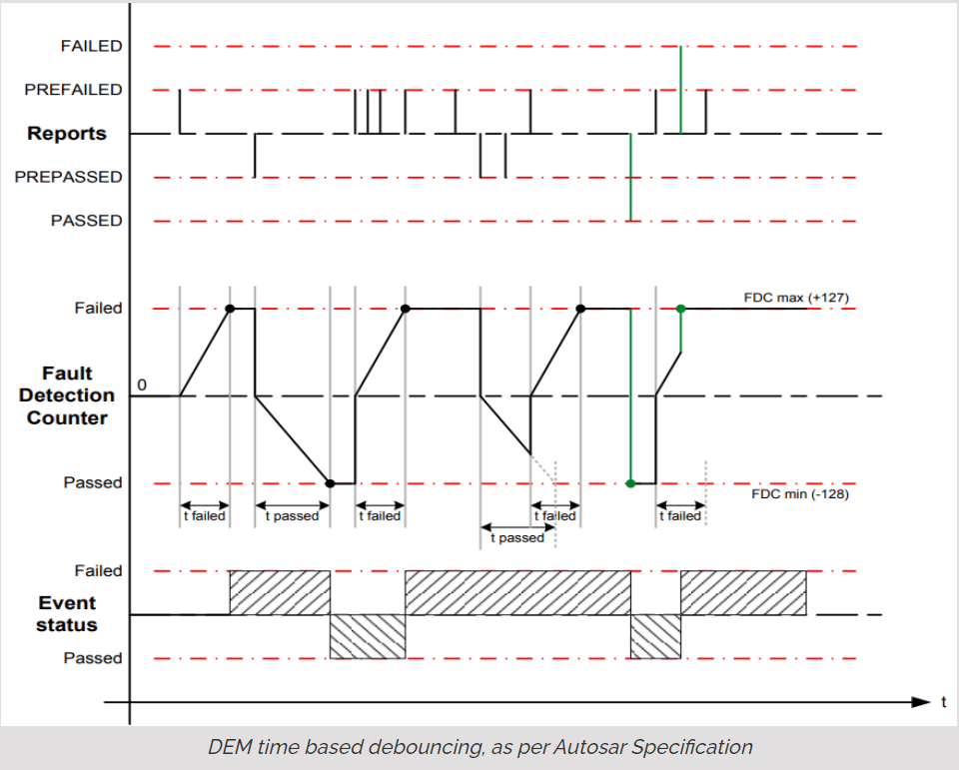
Time Based Debouncing - If an event is reported as PREPASSED or PREFAILED, after a certain time without an opposite event status, the event is automatically considered as PASSED or FAILED.
Internally Monitored Debouncing - in this debounce mode, you can take care of the debouncing yourself.(by BSW or SWC)

Slide 10
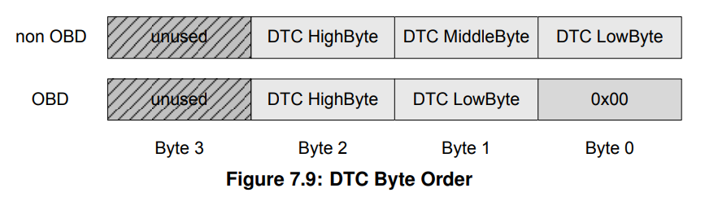
DTC
Diagnostic Trouble codes : unique identifier mapped to a Diagnostic event
Event : Passed or failed, status of DTC changes.
DTC status is stored in a byte called DTC status byte(4 byte long).

Slide 11
Types of DTCs
P – Powertrain. Includes engine, transmission, and associated accessories.
C – Chassis. Covers mechanical systems and functions: steering, suspension, and braking.
B – Body. Parts that are mainly found in the passenger compartment area.
U – Network & vehicle integration. Functions that are managed by the onboard computer system.
IPB :
Delta DTCs : Sensor fail/active, functional DTCs, Safety.
Porsche DTCs : Communication, Coding.
PAG Security

Slide 12
DTC status byte
Bit 0 : Test Failed
Bit 1 : This Failed This Operation Cycle
Bit 2 : Pending DTC
Bit 3 : Confirmed DTC
Bit 4 : Test Not Completed Since Last Clear
Bit 5 : Test Failed Since Last Clear
Bit 6 : Test Not Completed This Operation Cycle
Bit 7 : Warning Indicator Requested

Slide 13
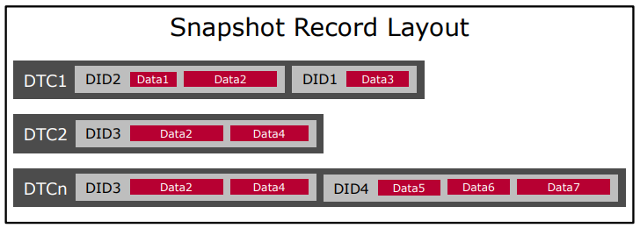
Snapshot and extended data
When event is failed then event related data can be stored into NVM
Snapshot data
Extended data
Freeze frame/Snapshot data contains a DID or multiple DIDs.
Eg: Event battery health, snapshot data : battery voltage and current
DEM will read each DID from application using client server port interface

Slide 14
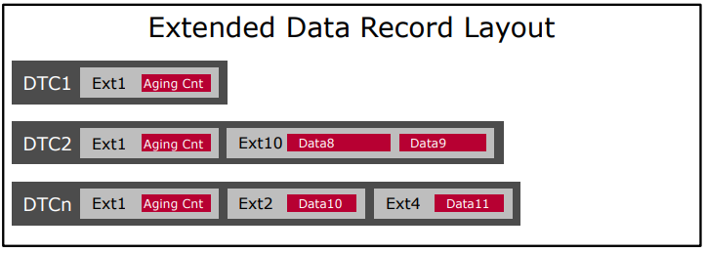
Extended Data Record is defined globally and consists of one or more data elements
Statistical data, eg: occurrence counter or aging counter that are not frozen at storage time

Slide 15
Event Aging
Event is stored into NVM, and event is no longer getting failed, then event starts aging and once event is aged, event is removed from memory
An aging cycle counter is started and incremented in each operation cycle if event is passed only in operation cycle and does not failed.
When aging cycle counter reached threshold value defined by user, event is removed from memory.

Slide 16
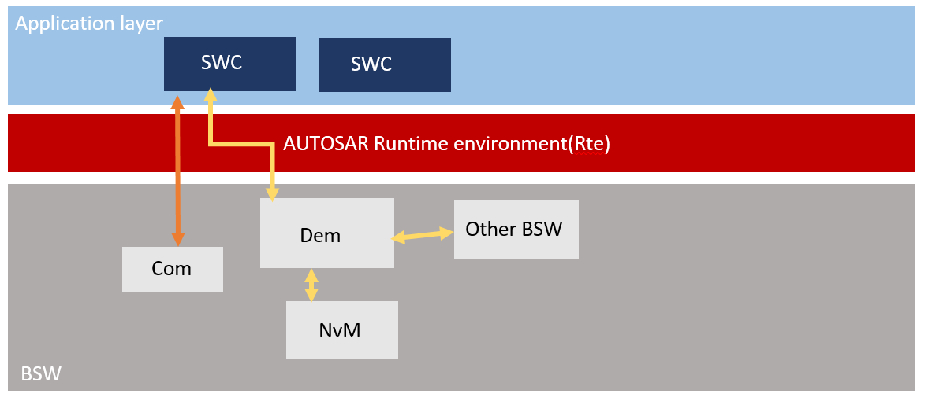
Flow

Slide 17
Fault memory

Slide 18
DCM Services

Slide 19
ReadDTCInformation – 0x19
The ReadDTCInformation 19hex service is used to read out events and notices that have occurred or are recognizable, as well as the associated additional information such as the environment data of a server
Subfunctions :
ReportNumberOfDTCByStatusMask (0x01)
ReportDTCByStatusMask (0x02)
ReportDTCSnapshotIdentification (0x03)
ReportDTCSnapshotRecordByDTCNumber (0x04)
ReportDTCExtendedDataRecordByDTCNumber (0x06)

Slide 21
Control DTC Setting(x85)
This service is used to disable and re-enable the updating of the status of DTC bits of events and notifications in a server's event store
Subfunctions:
Enable : 0x01
Disable : 0x02
If the service ControlDTCSetting and sub function Off/disable (0x02) is accepted by the server, the StatusOfDTC is no longer updated or the StatusOfDTC is frozen until the functionality

Slide 22
Demwrap

Slide 23
Configure
(To be updated)

Slide 24
Smarter. Greener. Together.

